Slide 1
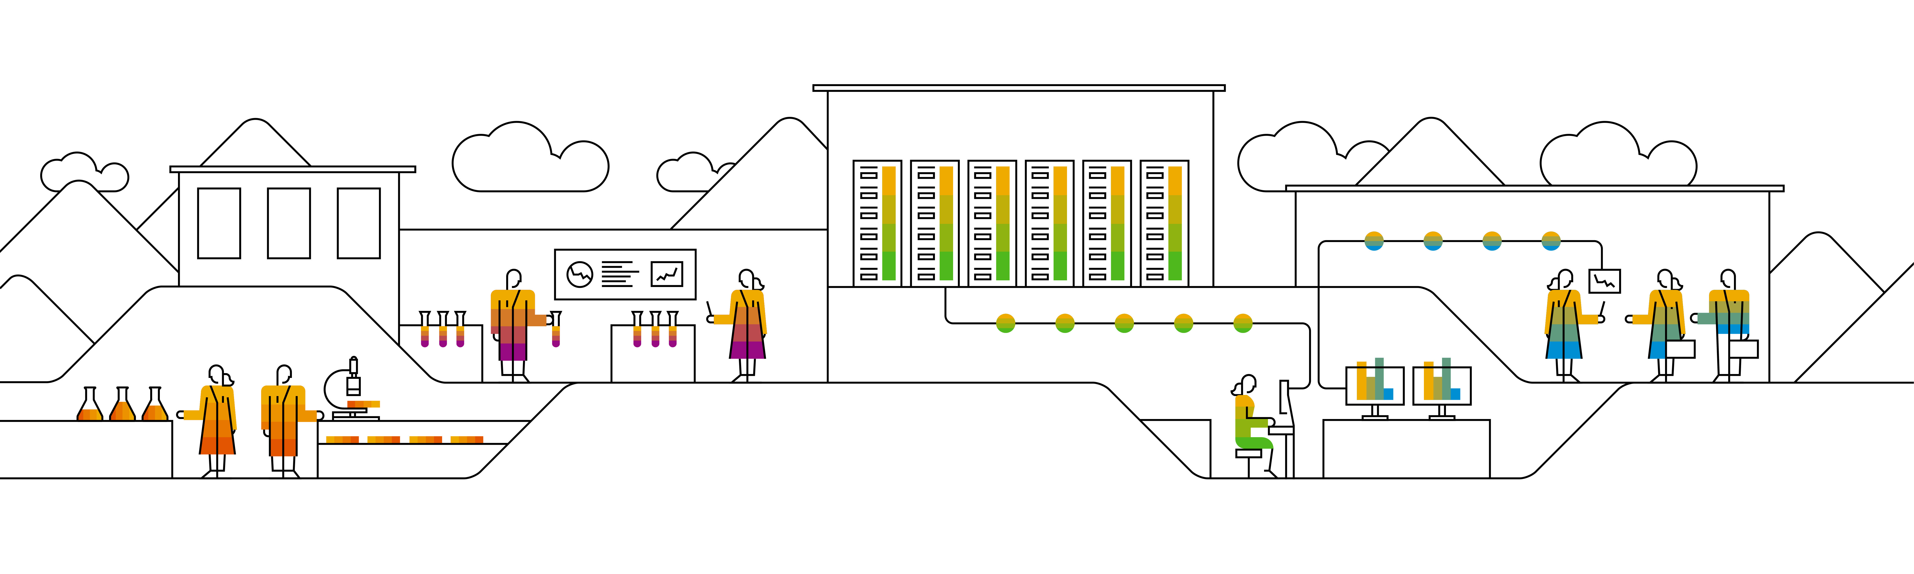
CockroachDB A Geo-distributed SQL Database
Speaker’s Name, SAP
Month 00, 2020
Partner logo

Slide 2
Agenda
Agenda item/divider headline
Details
Agenda item/divider headline
Details
Agenda item/divider headline
Details
Agenda item/divider headline
Details

Slide 3
The Overview of CockroachDB

Slide 4
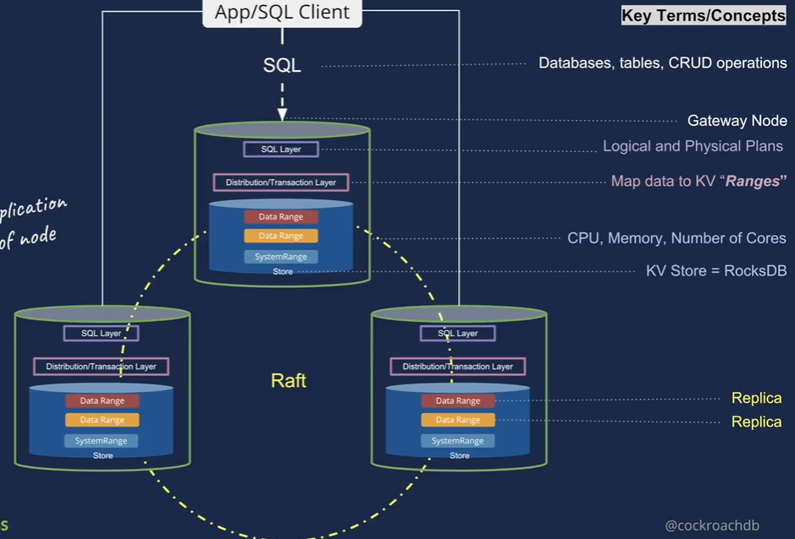
Introduction of CockroachDB
Make Data Easy
Distributed
Horizontally scalable to grow with your application
Geo-distributed
Handle datacenter failures
Place data near usage
Push computation near data
SQL
Lingua-franca for rich data storage
Schemas, indexes, and transactions make app development easier

Slide 5
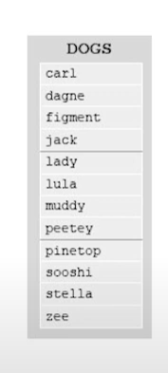
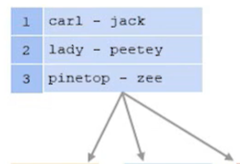
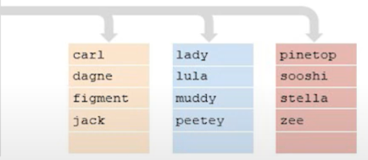
Distributed, Replicated, Transactional KV
Keys and values are strings
Lexicographically ordered by key
Multi-version concurrency control (MVCC)
Values are never updated in place
Tombstones are used to delete values
Provides snapshot to each transaction
Monolithic key-space
Key space divided into contiguous – 64MB
Ranges are small enough to moved/split quickly AND large enough to amortize indexing overhead
Index structure used to locate ranges

Slide 6
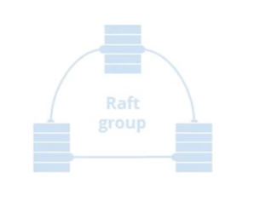
Raft and Replication
Ranges are the unit of replication
Each range is a Raft group
Raft is a distributed consensus protocol
Default to 3 replicas, though this is configurable
Raft provides “Atomic replication” of commands
Each group elects a leader
Commands require majority if replicas to vote

Slide 7
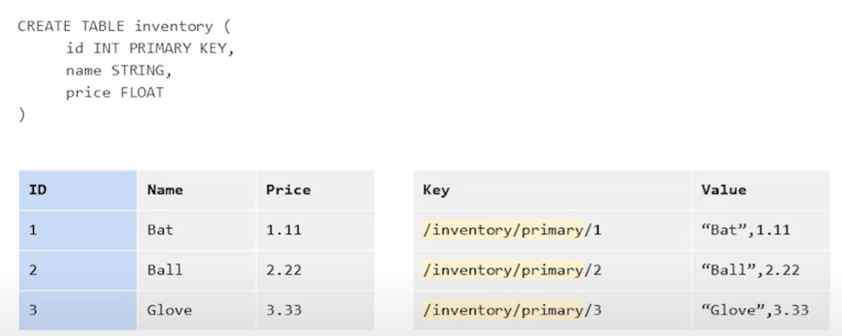
SQL: Tabular Data in a KV World
The SQL data model needs to be mapped to KV data
SQL Data Mapping: Inventory Table

Slide 8
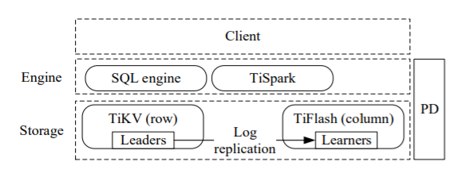

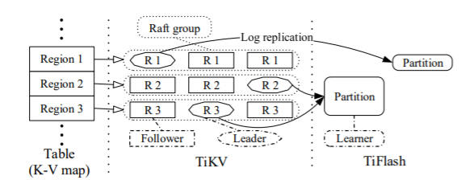
TiDB Architecture
It has three core components:
A distributed storage layer
A row store(TiKV)
A columnar store(TIFlash)
A Placement Driver
Managing regions
Supplying each key’s region and physical location
A computation engine layer

Slide 9
Insert page title (sentence case)
Each tuple is mapped into key-value pair:

Slide 10
Insert page title (sentence case)

Slide 11
Insert page title (sentence case)

Slide 12
Insert page title (sentence case)
First level
Second level
Third level

Slide 13
Insert page title (sentence case) Subheadline
First level
Second level
Third level

Slide 14
“Quote goes here and here and here.”
Source

Slide 15
“Quote goes here and here and here.”
Source

Slide 16
Insert page title (sentence case)
First level
Second level
Third level

Slide 17
Insert page title (sentence case)
First level
Second level
Third level

Slide 19
Insert page title (sentence case)
First level
Second level
Third level
First level
Second level
Third level

Slide 20
Insert page title (sentence case)
First level
Second level
Third level
First level
Second level
Third level
First level
Second level
Third level

Slide 21
Insert page title (sentence case)
First level
Second level
First level
Second level

Slide 22
Insert page title (sentence case)
First level
Second level
First level
Second level
First level
Second level

Slide 23
Thank you.
Contact information:
F name L name
Title
Address
Phone number
Partner logo

